Slide 1

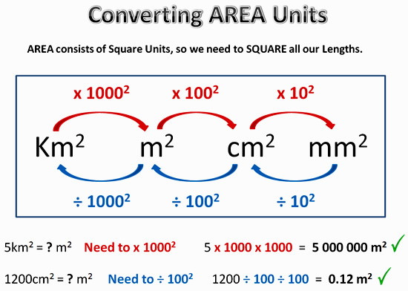
My Measurement Interactive Notebook
Name
Class
Teacher Mr Evans
Term 1 Semester 1
1

Slide 2
Contents
Glossary or Formula Page
Page
Date
Description
2
3

Slide 3
Tasks
24
7
30
Essential Question
Questions
Notes
Summary
6
7

Slide 4
In our last lesson we looked at how to find the surface area of a cuboid.
We learned:

Slide 5
24
7
30
Date
Topic : Volume and Surface Area of Rectangular Prisms
EQ – How do you find the volume and surface area of a prism?
How do I calculate the volume of a rectangular prism?
To find the volume of a prism, find the area of the base and
Multiply it by the height or length of the prism
Volume = height x width x depth
How do I calculate the surface area of a rectangular prism?

Slide 6
Area of a rectangle
Area of a rectangle = length x width
Area = 4 x 12
Area = 48cm²
4cm
12cm

Slide 7
Cuboids
A cuboid is a 3-dimensional shape made up of rectangles and/or squares
It has 6 faces
There are three pairs of identical faces

Slide 8
Surface Area
To find the surface area, find the area of the three different faces
C
Total Surface Area = 144 + 60 + 120
= 324cm²
S.A of A = 6 x 12
S.A of A = 72cm²
There are two faces with the same area as A, so multiply your answer by 2
2 x 72 = 144cm²
S.A of B = 5 x 6
S.A of B = 30cm²
There are two faces with the same area as B, so multiply your answer by 2
2 x 30 = 60cm²
S.A of C = 5 x 12
S.A of C = 60cm²
There are two faces with the same area as C, so multiply your answer by 2
2 x 60 = 120cm²
B
A
6cm
5cm
12cm

Slide 9
Now we are going to put it all together and find both the volume and surface area of the following cuboids.
Remember: Volume = Height x Width x Depth
Surface Area = Face 1 Length x Width x 2
Face 2 Length x Width x 2
Face 3 Length x Width x 2
Add the areas together.

Slide 10
I Do
7cm
4cm
15cm

Slide 11
We Do
7m
12m
7m

Slide 12
You Do

Slide 13
Notes Review
24, 7 ,30
Date
Title
Essential question
Notes complete
Notes complete with colour and diagrams
Questions completed
Contents page filled in
Formula page filled in

Slide 14
Homework
Review your notes and write a summary answering the essential question.

